Slide 1




Data Communication and Networks
Introduction
Dr. Spoorthi P Shetty
Associate Professor
Department of MCA
NMAM Institute of Technology, Nitte (Deemed to be University)

Slide 2




Trends in Data Communication and Networking for Today’s Enterprise
Traffic Growth
Development of New Services
Technological Advances
• Steady increase in both local (in-building) and long-distance communication traffic.
• High-speed networks at competitive pricing encourage more mobile applications.
• Mobile Broadband Traffic is exploding due to business use of smartphones and tablets.
• Expansion beyond voice/data to include image and video content.
• Growth in services and traffic capacity.
• Users Expect: High-resolution video/High-quality audio/Fast access to cloud and web applications.
• Business Demand Drivers: Web services/Remote access/Online transactions/Social networking.

Slide 3
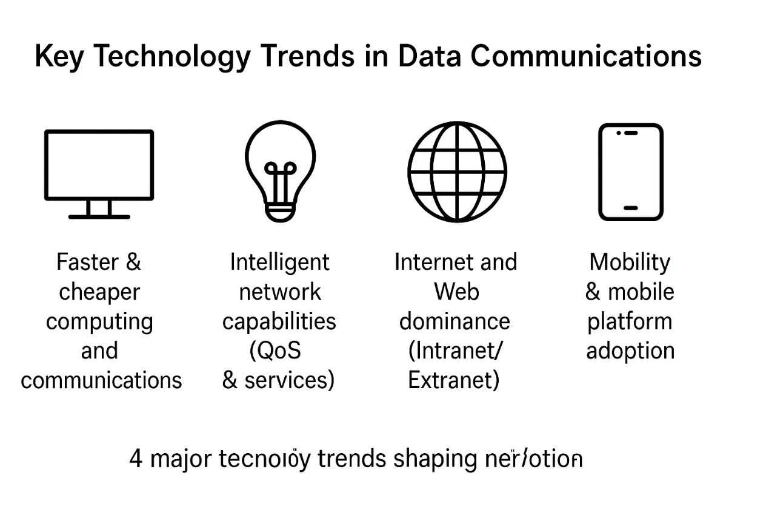
Data Communication and Networking for Today’s Enterprise
High-Speed LAN Requirements
Corporate Wide Area Networking (WAN) Needs
Impact of Digital Electronics

Slide 4



Convergence in Data Communication
Definition
Convergence = Merging of telephony and information technologies.
Unified platform for voice, data, and video services.
Enables seamless, integrated communication across systems.

Slide 5

Three-Layer Model of Convergence
Application Layer (End-User Level): Combines communication & business applications (e.g., Voice calling, voicemail, email, instant messaging).
Enterprise Services Layer (Network Management): Network viewed as a function-providing system. Services include: Design & support of convergence facilities, QoS management, Authentication & user access control, Capacity management for users, groups, apps.
Infrastructure Layer (Network Backbone): Voice, video, and image now transmitted over traditional data networks.
Mobile convergence: smartphones receive video, text, and data over cellular networks. Support for public/private cloud integration.

Slide 6

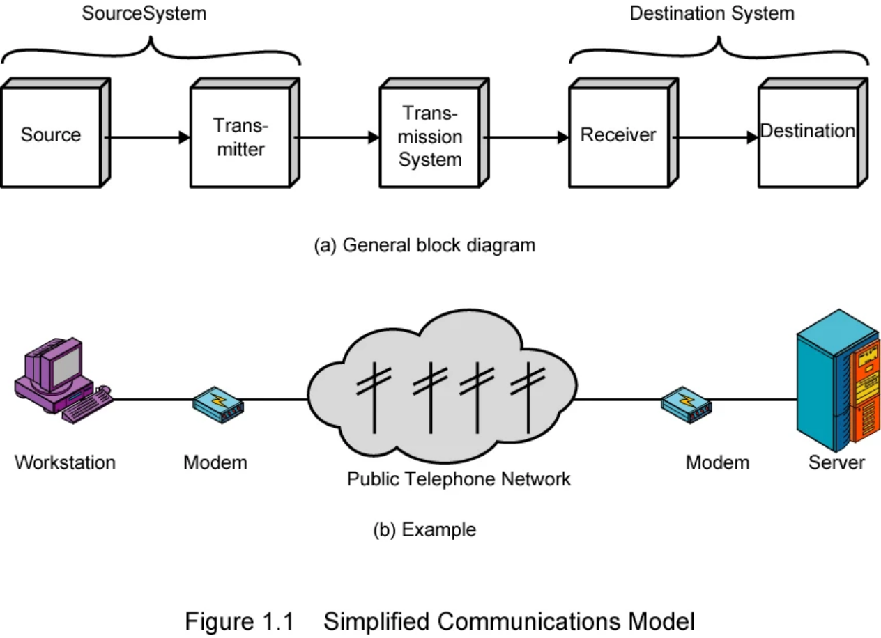
Communications Model
Source: Generates the original data. Examples: telephone, personal computer
Transmitter: Converts data from the source into transmittable signals. Performs transformation & encoding.
Example: Modem converts digital data to analog for telephone lines.
.
Transmission system: Medium through which signals are sent can be a
simple link or a complex network. Examples: transmission lines, fiber optics, internet backbone.
Receiver: Converts signals from the transmission system back into usable data. Example: Modem
Destination: Final endpoint that uses the received data. Example: computer, server, or any end-user device
.

Slide 7




Communications Tasks
1
2
3
4
5
Transmission System Utilization: Efficient use of shared transmission facilities, Multiplexing to share capacity.
Interfacing: Device must connect to transmission system, ensures compatibility and signal transmission readiness.
Synchronization: Receiver must recognize signal start, end, and timing - Essential for accurate data interpretation.
Signal Generation: Produces electromagnetic signals, must be suitable for transmission and interpretable by receiver.
Exchange Management: Rules for two-way communication, Includes connection setup, turn-taking, data format, and error handling.
.
.
.

Slide 8
Communications Tasks
6
7
8
9
10
Flow Control: Prevents sender from overwhelming the receiver, manages data transfer rate between systems.
Error Detection and Correction: Ensures data integrity, detects and corrects distorted or lost data during transmission.
Routing: Chooses path through the network, may involve dynamic path selection in large networks.
Addressing: Identifies intended recipient in multi-device networks, ensures correct delivery.
Recovery:
Deals with faults and interruptions, Allows resumption or rollback of communication session.

Slide 9
Communications Tasks
11
12
13
Security: Ensures privacy and data integrity, Prevents unauthorized access and tampering.
Network Management: Configuration, monitoring, and fault handling, Includes planning for future capacity and upgrades.
Message Formatting: Agreement on data structure and representation (e.g., character encoding), Ensures both parties interpret data identically.

Slide 10
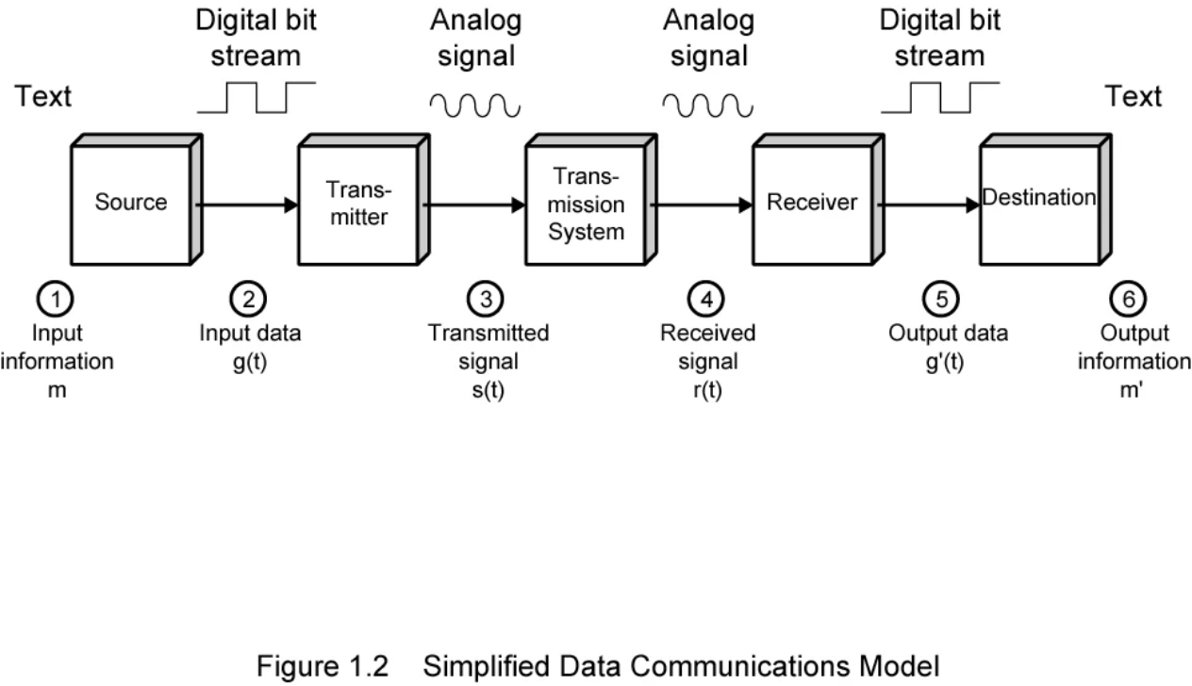
Data Communications

Slide 11


Networks
The Growing Need for Networks
Key Requirements
• Computers are rapidly increasing in number, power, and application scope.
• Communications software
• Networks
• Users demand seamless connectivity between systems.
Local Area Networks (LANs)
Wide Area Networks (WANs)
• Common in medium and large offices.
• Cover large geographic areas.
• Multiple types exist despite standardization.
• Used for voice, data, image, and video.
• Offices often require multiple interconnected LANs.
• High demand for integration and transmission capacity.
Fiber Optics
• Offer high bandwidth; switching systems are still evolving.

Slide 12

WAN Technologies
Circuit Switching: Dedicated path between stations. Example: Telephone network.
Packet Switching: Data sent as packets, stored and forwarded at each node. Ideal for computer-to-computer communication.
Frame Relay: Designed for low error, high-speed networks. Less overhead, supports up to 2 Mbps. Faster than traditional packet switching.
ATM (Asynchronous Transfer Mode): Fixed-size cells vs. variable-size frames in Frame Relay. Minimal error control overhead. Supports 10s to 100s of Mbps, even Gbps. Allows dynamic virtual channels with varied data rates. Combines benefits of circuit and packet switching.

Slide 13


Local Area and Wireless Networks
Flow Control
• Interconnects devices within a limited geographic area (e.g., building/campus).
• Owned and managed by the organization using it.
• Offers high internal data rates.
Types of LANs
• Switched LANs: Typically switched Ethernet.
• ATM LANs and Fibre Channel.
• Wireless LANs: Use various wireless technologies.
Differences from WANs
• Smaller scope.
• Fully user-owned and maintained.
• Higher data transfer speeds.
Wireless Networks
Used in both LAN and WAN environments.
• Enable mobility, easy setup, and flexible configuration.
• Widely adopted in business and communication systems.

Slide 14


The Evolution of the Internet
Originated from ARPANET (1969), funded by the U.S. DoD.
First operational packet-switching network.
Developed into the global Internet, now spanning billions of users and millions of hosts.
Key contributors: Vint Cerf & Bob Kahn – developed TCP/IP protocols.

Slide 15
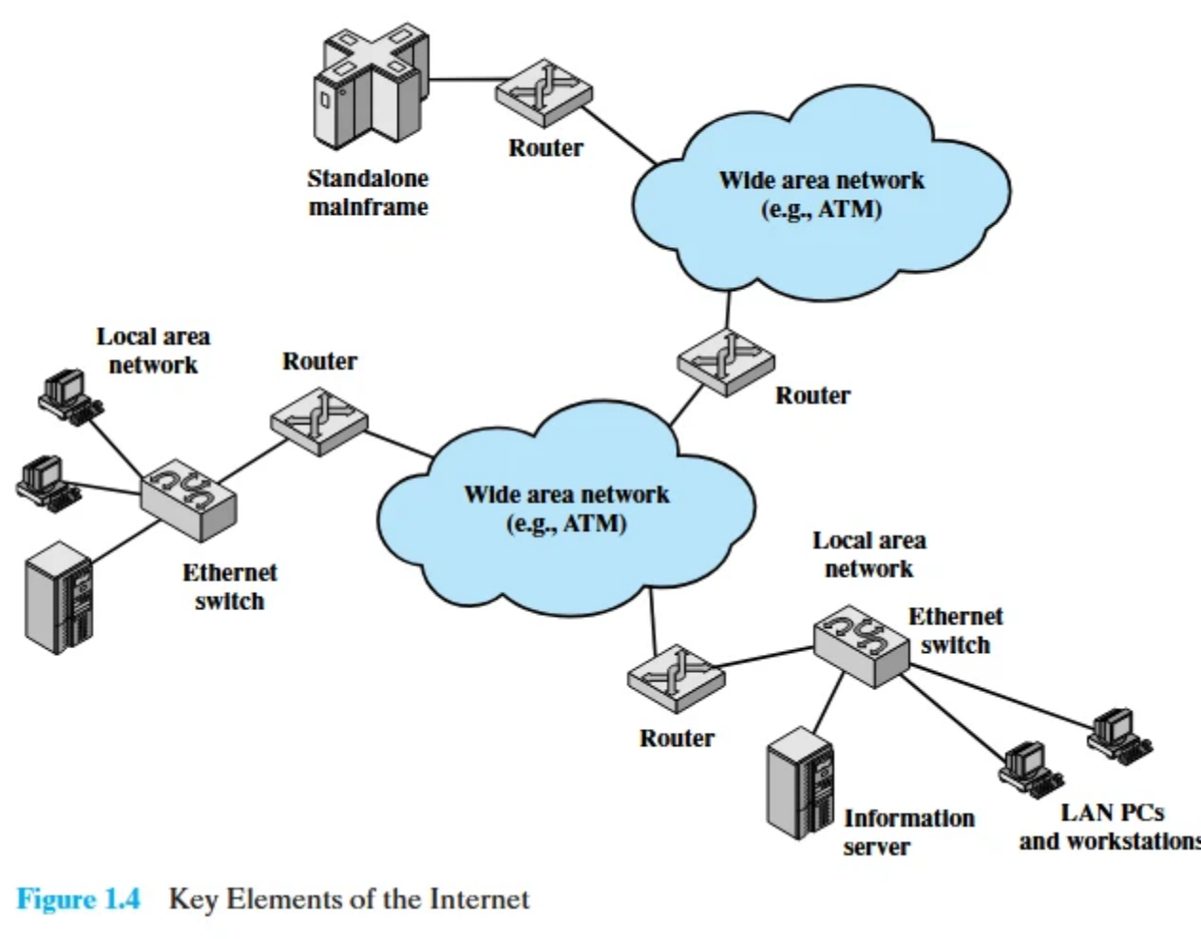
Internet Architecture
Hosts: (PCs, servers, mobile devices) connected via LANs/WANs.
Routers: Connect multiple networks, directing packets based on IP addresses.
IP Datagrams: Routed from source to destination across networks.
Internet formed by hierarchical overlapping networks.
Customer Premises Equipment (CPE): Connects users to ISP POPs.

Slide 16
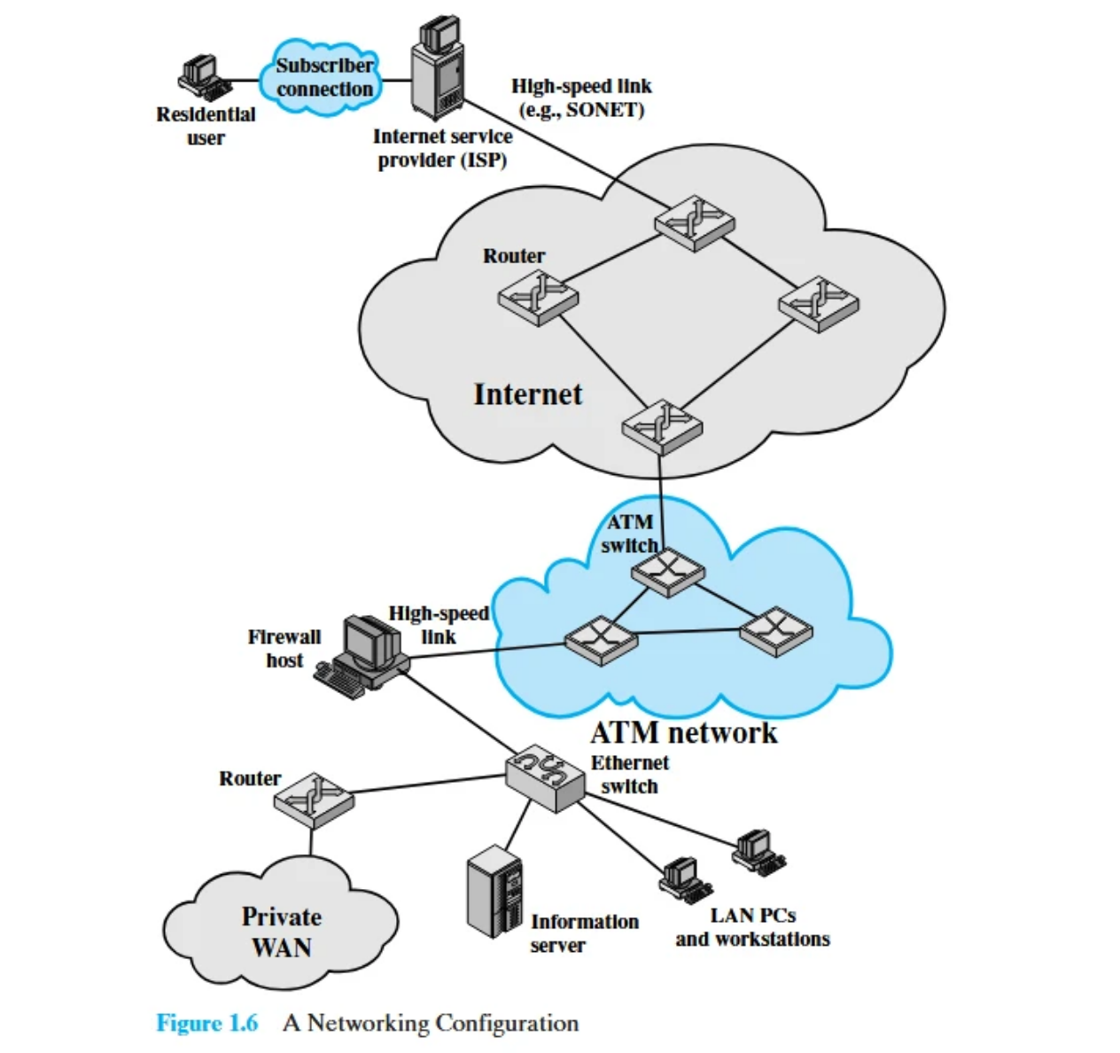
Access, Peering & Example Configuration

Slide 17


Access, Peering & Example Configuration
Access Technologies & Connections
• Common user connections:
• Dial-up (56Kbps), DSL, Cable Modem, Fiber.
CPE and Local Loop
• CPE connects to the Local Loop (the “last mile” to ISP).
• ISPs provide: IP address, name resolution, network access.
Peering & Network Backbone
• ISPs connect via POPs, NAPs, and NSPs.
• NAPs: Major interconnection hubs for ISPs (e.g., MAE West).
• NSPs: Provide backbone services and peering agreements.
Example Configuration
• Residential user connects via DSL/Cable to ISP.
• ISP connects to Internet via high-speed SONET links.
• Business LAN uses Ethernet, connects to Internet via firewall.
• Private networks can connect through ATM/WAN routers.

Slide 18

Thank You

